Slide 1
Real-time Remote Health Monitoring System
IN 1900 – ICT Project
IT Group No : 18
Group Member | Index No.
B. M. C. Rathnayaka | 164112H
Jeayaranjan Kisojan | 164070B
Jayarajah Tharsegan | 164135F
P. M. K. T. Tharuka | 164136J
H. M. M. Akram | 164201F

Slide 2
Problem in brief
In today’s healthcare practice, Doctors have a need to monitor more than one medical parameter from patients. We need device that it should allow doctors to view the measured parameters over long period of time for analysis.
In the hospital, patient’s Body Temperature, Heart Beat rate and other parameters must need to be monitored constantly. This is usually done by doctor or other paramedical staff.
They observe that data from patients constantly and maintain a record of it in papers. That is not Environment Friendly.
Today there is no device to monitor on-time patient’s parameters wirelessly. If doctors can get these parameters wirelessly, it is very useful for both patients and doctor.

Slide 3
Project Aim & Objectives
Project Aim:
To develop an automated health monitoring system.
Objectives:
To Develop a Platform that has the capability to
Collect Heart Rate, Blood Pressure, Respiration Rate, Saline Level and Body Temperature data
Enable the device to display the parameters
To Send warning messages to doctor and other paramedical staff in case of abnormal conditions.

Slide 4
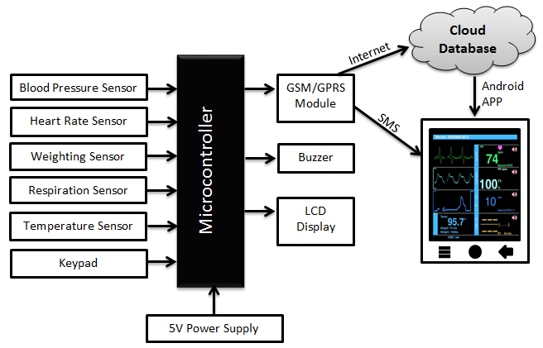
System Diagram & Description
Figure: System Diagram
Collect Heart Rate, Blood Pressure, Respiration Rate, Saline Level and Body Temperature data from sensors.
It displays the result of these to the doctor through LCD display and Mobile app using GPRS Technology.
We use buzzer to generate warning signal, If the parameters cross the safe limit.

Slide 5
Resources & Estimated Cost
Component | Price
1Kg Load Cell with HX 711 Module | Rs. 750
MPS20N0040D-D with hx711 | Rs. 520
LM35 Terminal Sensor Module x 2 | Rs. 240
ATMEGA32A Chip | Rs. 325
4x4 Matrix Keyboard | Rs. 150
SIM900A GSM/ GPRS Module | Rs. 1,800
Power Supply 230V AC to 12v 2A DC | Rs. 400
USB ASP + Developer Board | Rs. 900
16 x 4 Display | Rs. 750
5v Buzzer | Rs. 25
Blood Pressure Sensor + Solenoid Valve + Air Pump + hand cuff | Rs. 3,400
Other Components | Rs. 950
Total | Rs. 10,210

Slide 6
Thank You!!

